Slide 1
SNAKE GAME USING PYTHON

Slide 2
ABSTRACT
Snake game is a popular classic arcade game that involves controlling a snake to eat food while avoiding obstacles and its own body. In this project, we aim to develop a Snake game using Python programming language. The game will utilize Python’s built-in modules such as Pygame, which is a popular module used for game development. The project will involve designing the game board, the snake, the food, and the game mechanics. The user will be able to control the snake’s movement using arrow keys, and the game will end when the snake collides with the wall or its own body. The project will also involve keeping track of the player’s score and displaying it on the screen. Overall, this project will be a fun and challenging way to practice Python programming skills while creating a classic game.

Slide 3
INTRODUCTION
Snake game is a classic video game that has been popular for decades, involving controlling a snake that moves around a screen and eats objects labeled as "food."
Pygame is a Python module that provides functionalities for game development, allowing developers to easily create games with graphics, sound, and user input.
The snake game implemented using Pygame in Python involves controlling a snake that moves around the screen and eats bait to grow, while avoiding colliding with the walls or the snake's body.
This code offers a simple yet entertaining example of how the Pygame module can be used to create a game with basic features such as movement, collision detection, and score tracking.
The game features a snake that constantly moves on the screen, and the player can control the snake's movement using the arrow keys.
Unlike traditional snake games, this game does not have any visible food items, and every time the snake collides with an invisible bait, it disappears, and the snake's body grows.
The game keeps track of the player's score, which increases with each successful collision of the snake with the bait.

Slide 4
The code employs different functions to execute the various tasks involved in the game, making the code modular and easy to manage.
Overall, the snake game implemented using Pygame in Python is a fun and simple game that showcases the capabilities of the Pygame module for game development.

Slide 5
PROPOSED MODEL
The proposed system is a simple game implemented using the Pygame module, featuring a snake that moves around the screen. The game objective is to prevent the snake from hitting walls or colliding with its own body.
The snake's movement is controlled using the arrow keys, and it initially moves to the right direction. Unlike traditional snake games, there will be no visible objects labeled as "food" on the screen. Instead, there will be an invisible bait that disappears every time the snake hits it, and the snake's body grows.
The proposed system will keep track of the player's score, which increases every time the snake successfully hits the bait. The game ends if the snake hits a wall or collides with its own body.

Slide 6
To implement the proposed system, we will use the Pygame module and develop functions to handle the snake's movement, collision detection, and scorekeeping. We will also design a graphical interface for the game using Pygame's graphics capabilities.
The proposed system will be a fun and challenging game that will test the player's reflexes and strategic thinking, providing an entertaining experience for users of all ages.

Slide 7
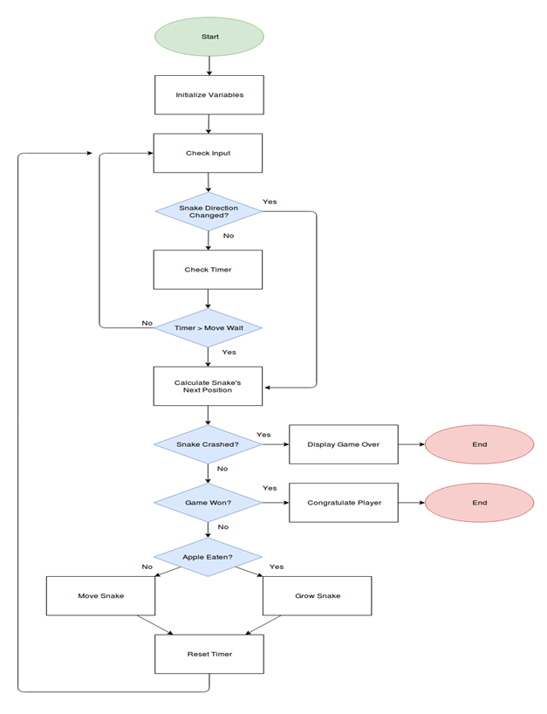

Slide 8
FUTURE WORK
Adding more levels with increasing difficulty: As the player progresses through the game, the speed of the snake could increase or more obstacles could be added to make the game more challenging.
Multiplayer functionality: The game could be enhanced to include a multiplayer mode where two players can compete against each other to see who can score the most points.
Power-ups: Power-ups could be added to the game that would give the player an advantage, such as invincibility or increased speed.
Sound effects and music: Adding sound effects and music to the game could enhance the player's experience and make the game more engaging.
Mobile compatibility: The game could be made compatible with mobile devices so that players can play it on the go.

Slide 9
Customization options: The player could be given the option to customize the snake's appearance or the game's background to make the game more personalized.
Adding different game modes: The game could be enhanced with different game modes such as time trials or survival mode, where the player has to survive for as long as possible without colliding with any obstacles.

Slide 10
REFERENCES
1."How to Build Snake Game Using Python and Pygame," by Shashwat Jaiswal, https://www.geeksforgeeks.org/how-to-build-snake-game-using-python-and-pygame/
2."Create the Classic Snake Game with Python in One Hour," by freeCodeCamp.org, https://www.freecodecamp.org/news/create-the-classic-snake-game-with-python-in-one-hour-8fc3611cfa9/
3."Python Snake Game Tutorial for Beginners - Full Code with Pygame," by Christian Thompson, https://www.youtube.com/watch?v=CD4qAhfFuLo
4."Python Game Development Tutorial - Snake Game," by Tech With Tim, https://www.youtube.com/watch?v=QFvqStqPCRU
5."Snake Game Python Tutorial," by TokyoEdTech, https://www.youtube.com/watch?v=VLZjd_Y1gJ8
6."Creating Snake Game Using Python with Pygame," by Piyush Verma, https://towardsdatascience.com/creating-snake-game-using-python-with-pygame-8b7efc9c589

Slide 11
7."Build Snake Game Using Python and Pygame - Full Tutorial," by Rasika Gayan, https://www.techwithrasika.com/2021/01/28/build-snake-game-using-python-and-pygame-full-tutorial/
8."Python Snake Game - Tutorial," by Zenva Academy, https://academy.zenva.com/lesson/snake-game-python-tutorial/
9."Python Game Tutorial: Snake," by Ben Tristem, https://www.udemy.com/course/python-game-development-creating-a-snake-game-from-scratch/
10."How to Make a Simple Snake Game in Python," by Trevor Appleton, https://www.twilio.com/blog/how-to-make-a-simple-snake-game-in-python
11."How to Build Snake Game Using Pygame in Python," by Arpit Bhartiya, https://thepythonguru.com/how-to-build-snake-game-using-pygame-in-python/
12."Pygame Tutorial: Creating Snake Game in Pygame," by Code Young, https://codeyoung.blogspot.com/2019/09/pygame-tutorial-creating-snake-game-in.html

Slide 12
THANK YOU

